Slide 1


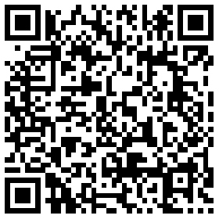
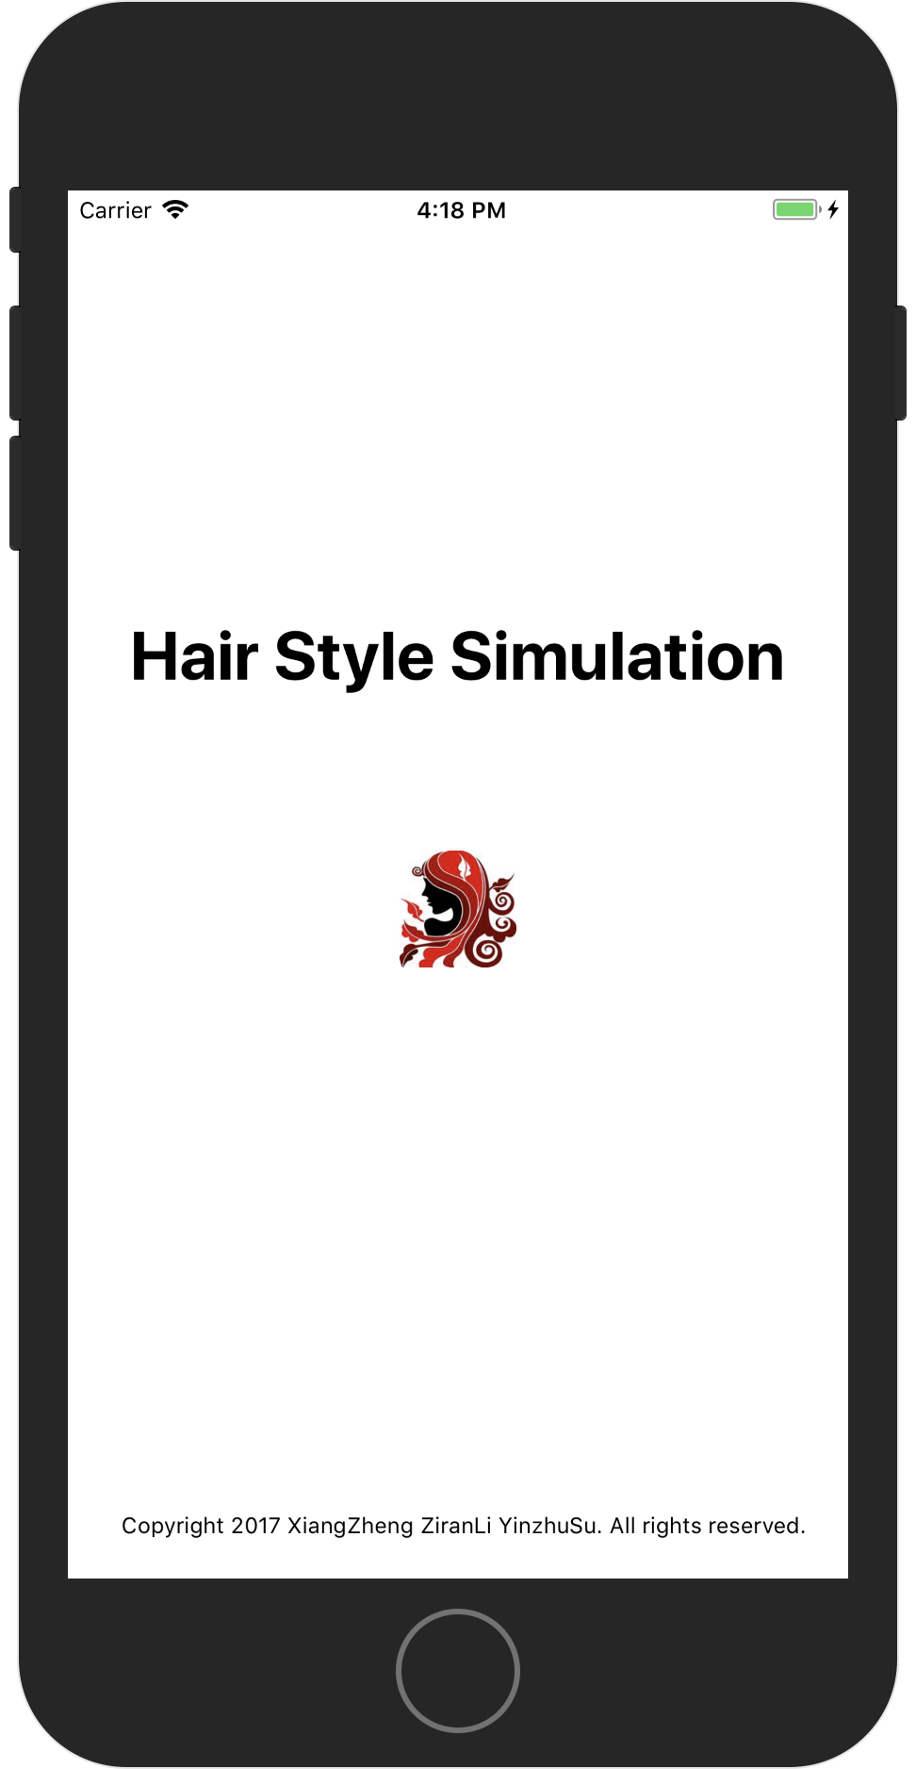
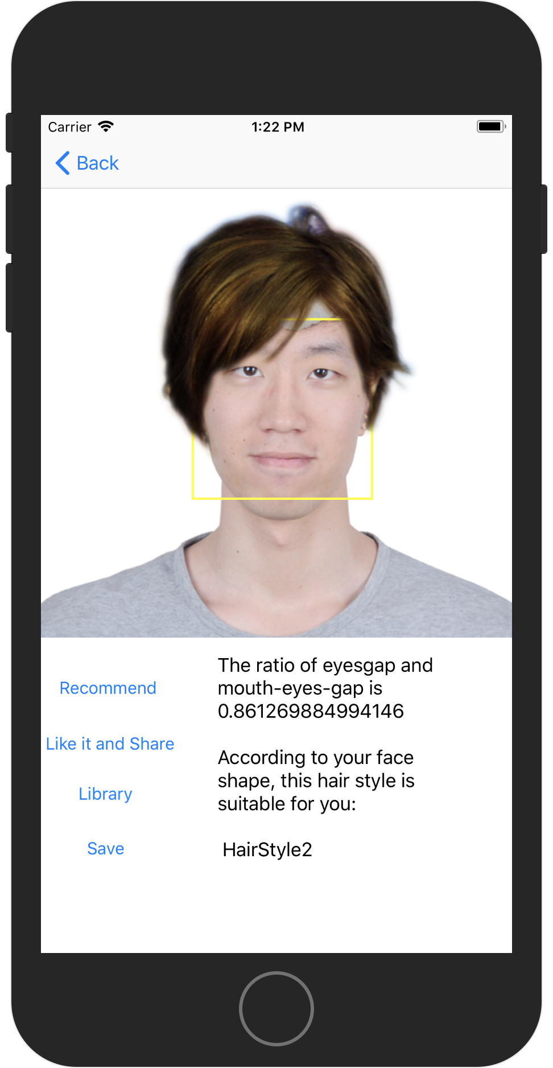
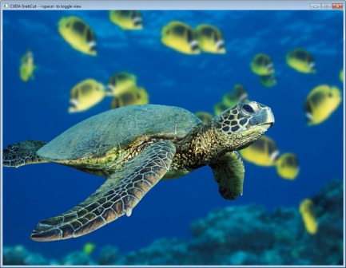
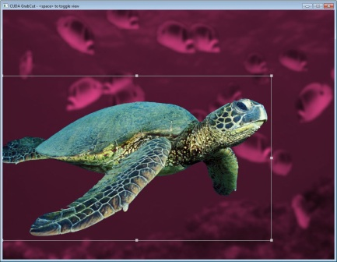
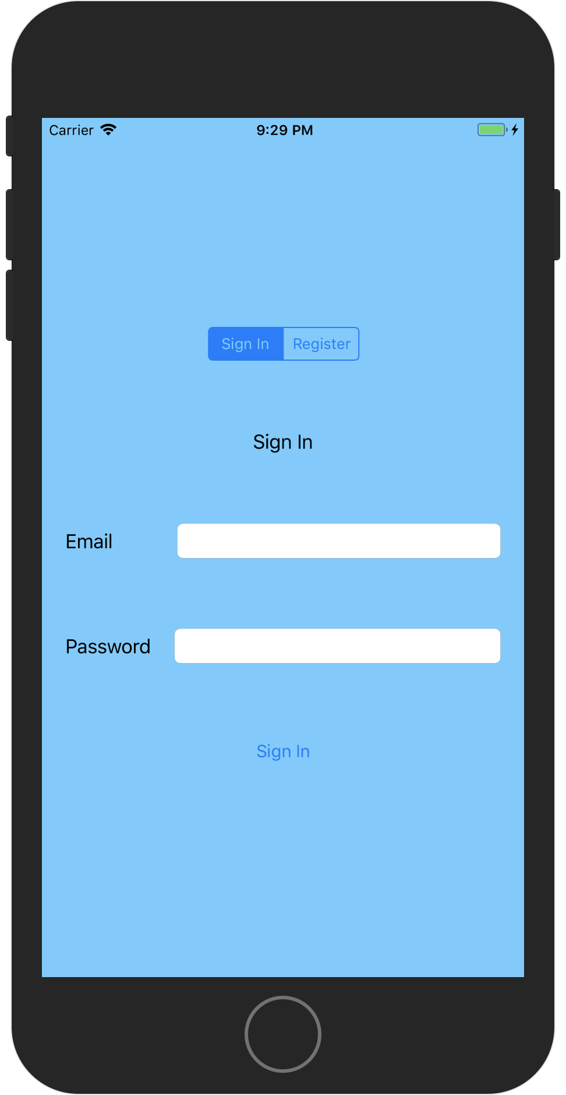
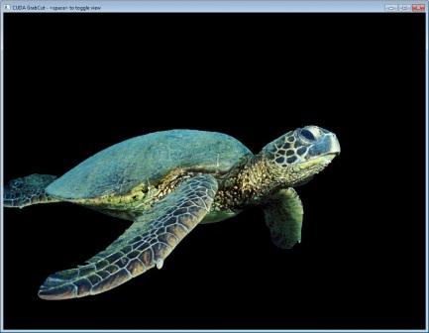
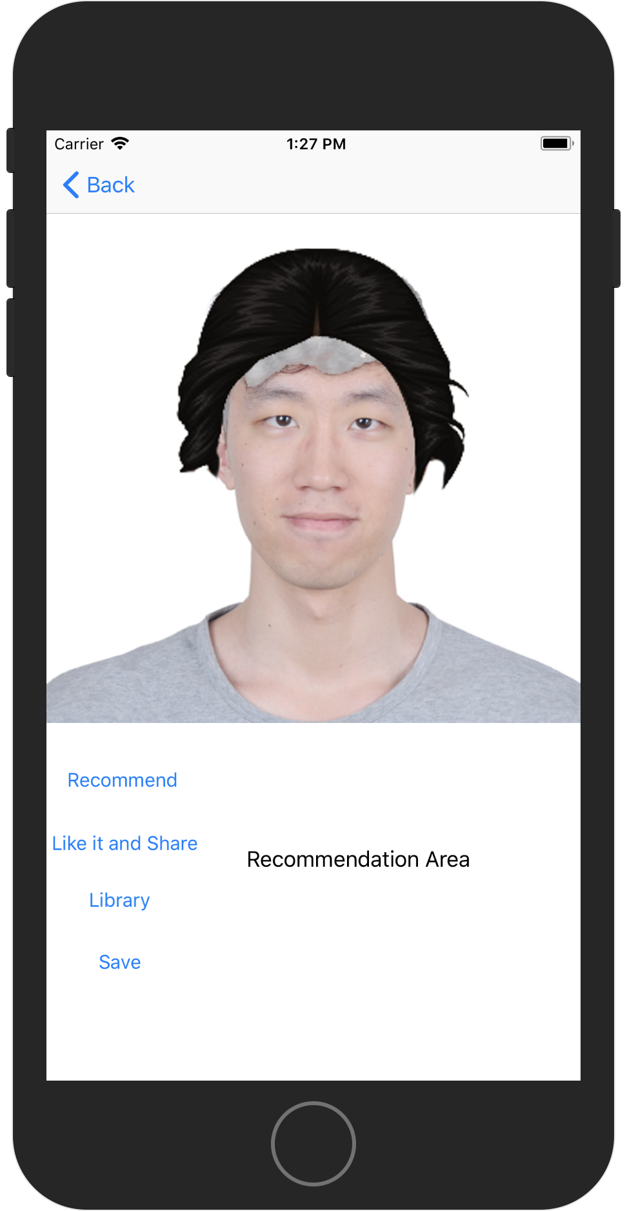
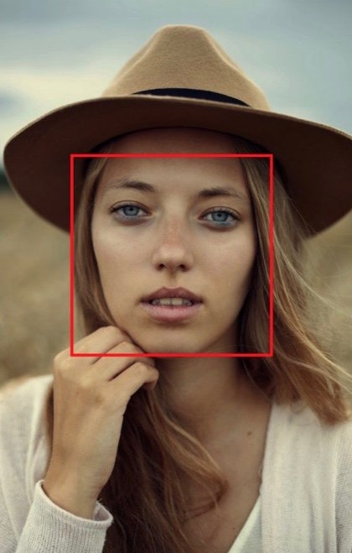
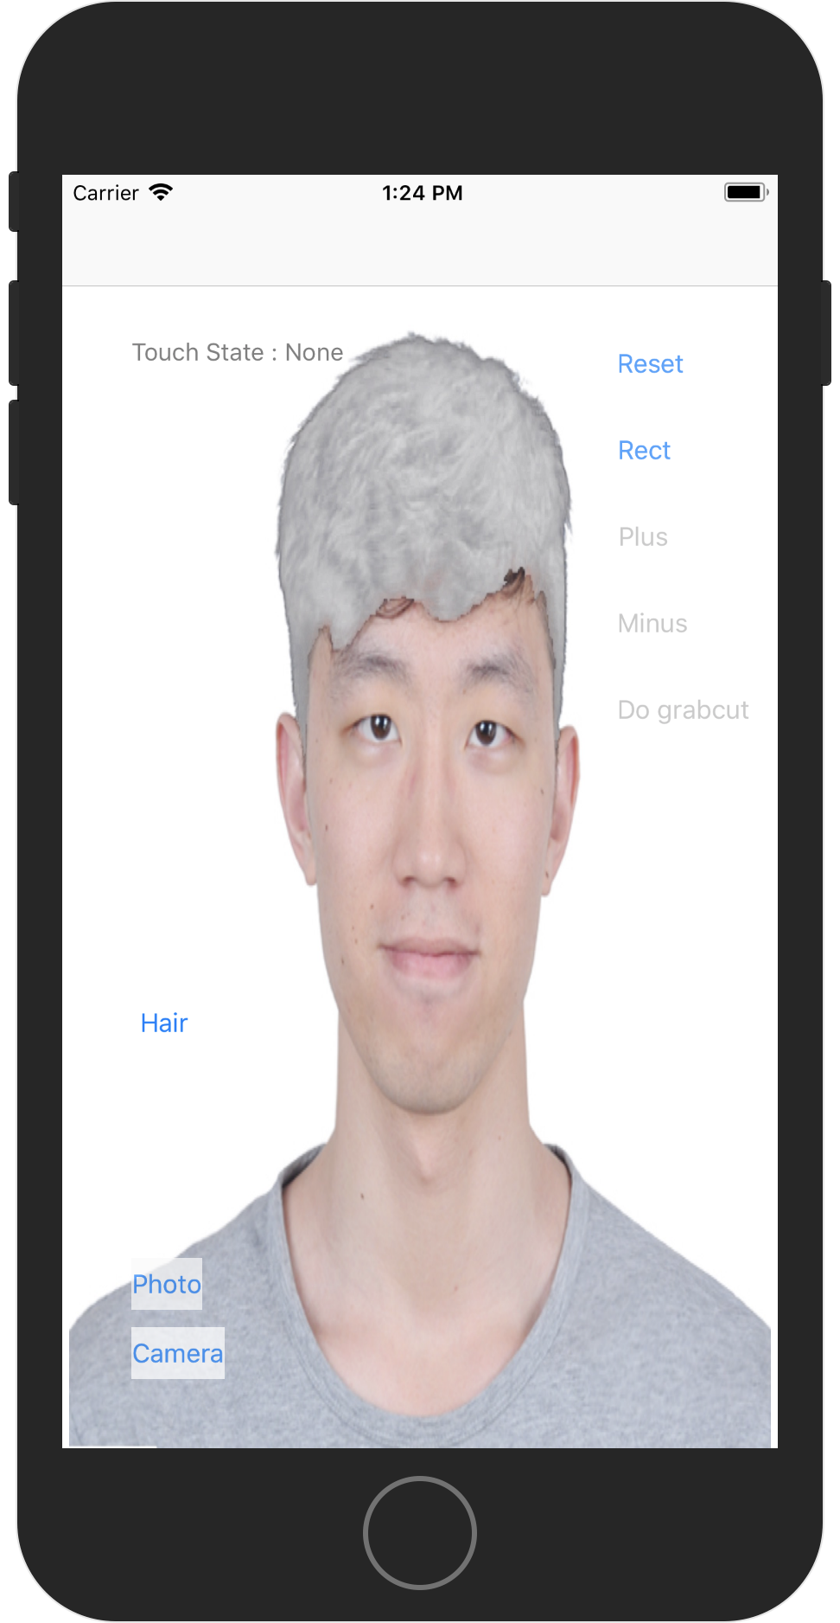
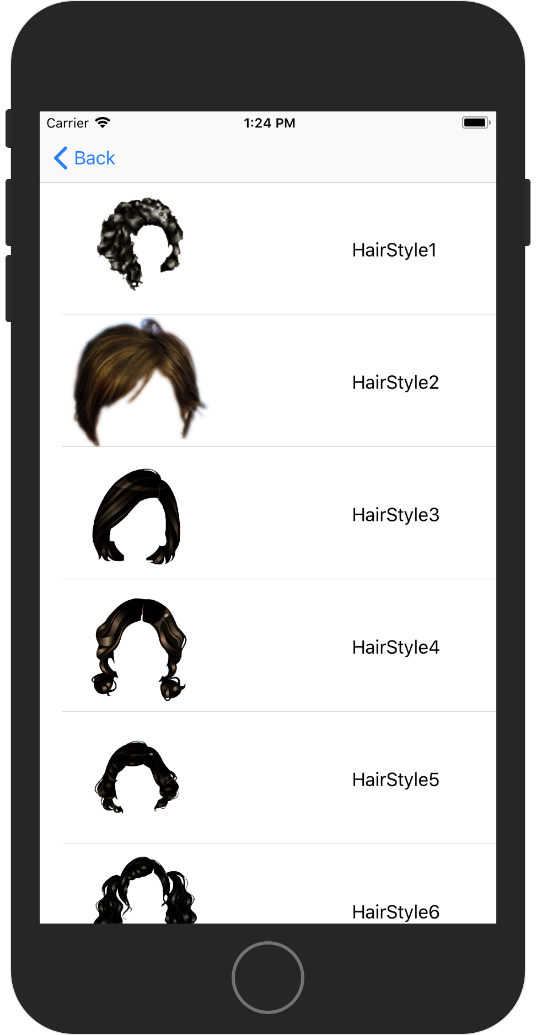
HAIRSTYLE SIMULATION
Xiang Zheng Ziran Li Yinzhu Su
Department of Electrical& Computer Engineering Boston University
zhengx95@bu.edu zrli@bu.edu yzsu@bu.edu
Github
Trello
Introduction
MAIN TECHNIQUE
Recommendation
iOS application
Detect human hair with user interaction
Remove the old one, try new hairstyles on!
GrabCut
Core Image algorithm
Based on face’s data, give hairstyle recommendation
An image segmentation algorithm based on graph cuts
Using a Gaussian mixture model, estimates the color distribution of the target object and background.
As this estimation is likely to be more accurate than the original, taken from the bounding box, this two-step procedure is repeated until convergence.
Estimation can be further corrected by the user by pointing out misclassified regions and rerunning the optimization. The method preserve edges.
Firebase
Match Your Face
Register with email
Already registered? Sign in!
Google Firebase
Hairstyle matching
Zooming Using the Pinch Gestures
Core Image
An image processing and analysis technology that provides high-performance processing for still and video images.
Use many built-in image filters to process images and build complex effects by chaining filters.
In our app, we use Core Image to detect human face and collect detailed information, such as eyes’ position and mouth’s position,
The data was sent to the backend of the app, then calculate the user’s face shape so that our app give recommended hairstyle according to their face shape.
GrabCut
Select Hairstyles
GrabCut algorithm
Interactive Foreground Extraction
Hairstyle selection
10 hairstyles till now
More will be uploaded
User Story
Accomplishments
I, user, want to create an account via social media or email address.
I, user, want to remove my hair.
I, user, want to try different hairstyles matching with my face.
I, user, want to get suggestions of hairstyles from the App.
I, user, want to share my favorite picture to social networks.
The user can create an account via email address then log in.
The user can remove their hair in the picture using our App.
The user can try new hairstyles in the table view.
The user can get suggested hairstyle according to their face shape.
The user can share their favorite picture via e-mail.

